Slide 1
Main Memory

Slide 2
Memory Hierarchy
Memory hierarchy is arranging different kinds of storage present on a computing device based on speed of access.
Separates the computer storage based on hierarchy.
Registers
Registers are present inside the CPU. As they are present inside the CPU, they have least access time. Registers are most expensive and smallest in size generally in kilobytes.
Cache memory
Used to store the segments of a program that are frequently accessed by the processor. It is expensive and smaller in size generally in Megabytes
Main memory
Directly communicates with the CPU and with auxiliary memory devices through an I/O processor. Main memory is less expensive than cache memory and larger in size generally in Gigabytes.

Slide 3
Memory Hierarchy
Secondary memory
Secondary memory like magnetic disk are present here. They are used as permanent storage. They are cheaper than main memory and larger in size generally in a few TB.
Tertiary memory
Tertiary storage devices like magnetic tape are present at this level. They are used to store removable files and are the cheapest and largest in size (1-20 TB).

Slide 4
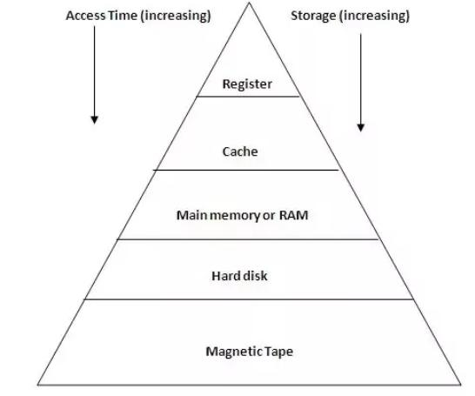
Memory Hierarchy

Slide 5
Background
Memory consists of a large array of words or bytes, each with its own address. The CPU fetches instructions from memory according to the value of the program counter
After the instruction has been executed on the operands, results may be stored back in memory. The memory unit sees only a stream of memory addresses; it does not know how they are generated
Memory unit only sees a stream of:
addresses + read requests, or
address + data and write requests
Protection of memory required to ensure correct operation

Slide 6
Logical Address
Logical Address (Virtual Address)
A logical address (also called a virtual address) is the address generated by the CPU during program execution.
It’s the address that a process thinks it’s using.
Each process has its own logical address space, usually starting at 0.
Example: If a program accesses memory location 100, that’s a logical address — it’s not yet tied to a real RAM address.

Slide 7
int x = 10;
int *p = &x;
printf("%p", p);
p stores the address of x, but this address is a logical (virtual) address.
The OS and MMU translate this logical address → to the physical address where x actually resides in RAM.
So, the value printed by printf("%p", p); is a virtual address, meaningful only within your process — not the real hardware address.

Slide 8
Physical Address
Physical Address
The physical address is the actual location in RAM where the data or instruction resides.
The Memory Management Unit (MMU) or address binding mechanism translates the logical address into a physical address.
Example: If the MMU maps logical address 100 to physical address 3100, then the data at RAM[3100] is accessed.

Slide 9
Base Register
Base Register
The base register holds the starting physical address of a process’s memory area in RAM.
It is used by the MMU to translate logical → physical addresses dynamically.
Example: If base register = 3000 and logical address = 100 Physical address = 3100

Slide 10
Limit Register
Limit Register
The limit register holds the size (range) of the process’s address space.
It specifies the maximum valid logical address a process can generate.
The MMU checks:
If (Logical Address < Limit Register) [within the range]
Access is valid
Else
Trap → Access is invalid, and a trap is generated by the hardware to the operating system's kernel
Example: If limit register = 1200 Process can legally access logical addresses 0–1199 only.

Slide 11

Protection
Need to ensure that a process can access only those addresses in its address space.
We can provide this protection by using a pair of base and limit registers which define the logical address space of a process

Slide 12
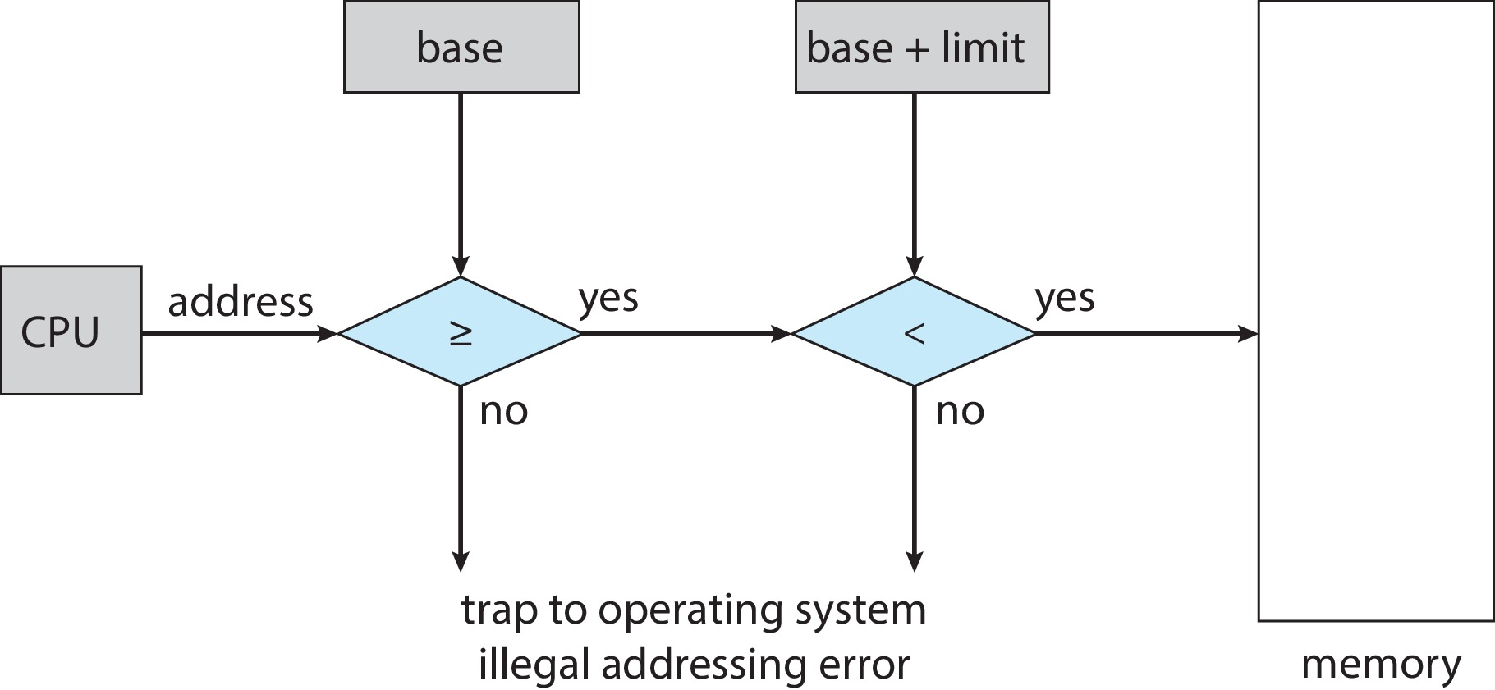
Hardware Address Protection
CPU must check every memory access generated in user mode to be sure it is between base and limit for that user

Slide 13
Address Binding
A program resides on a disk as a binary executable file (a file that contains a program in machine code — instructions that the CPU can execute directly).
The program must be brought into memory and placed within a process for it to be executed.
Depending on the memory management in use, the process may be moved between disk and memory during its execution.
The collection of processes on the disk that is waiting to be brought into memory for execution forms the input queue.
Normal procedure is to select one of the processes in the input queue and to load that process into memory.
As the process is executed, it accesses instructions and data from memory.
Eventually, the process terminates, and its memory space is declared available.

Slide 14
Address Binding
Addresses represented in different ways at different stages of a program’s life
Source code addresses usually symbolic addresses
Compiled code addresses bind to relocatable addresses
i.e., “14 bytes from beginning of this module”
Linker or loader will bind relocatable addresses to absolute addresses
i.e., 74014
Each binding maps one address space to another

Slide 15
Address binding
Source Code Stage (Symbolic Addresses)
Written by the programmer.
Uses variable names or labels instead of actual memory locations.
Example:
int total = a + b;
Here total, a, and b are symbolic addresses.
Compilation Stage (Relocatable Addresses)
The compiler translates source code into machine instructions.
It doesn’t yet know where in memory the program will be loaded.
So, it assigns relocatable (relative) addresses, like:
"variable x is at offset 14 bytes from start of code segment"
These addresses are relative, not fixed.

Slide 16
Address binding
Linking and Loading Stage (Absolute Address/ Actual Address)
The linker combines multiple object files (modules) and assigns absolute addresses.
The loader then places the entire program into main memory, starting at a chosen base address.
For example:
The program is loaded starting at address 74000 (base register)
So, the relocatable address +14 becomes 74014 (actual address)

Slide 17
Source Code (.c/.cpp)
↓ (compiled)
Object Code (.o/.obj)
↓ (linked)
Executable File (.exe/.out)
↓ (loaded)
Program in Memory (ready to run)

Slide 18
Linking is the process of combining one or more object files (and libraries) into a single executable file, and resolving all symbol references (functions, variables, etc.) among them.
When you compile a program, each source file is compiled separately into an object file. But functions and variables can be defined in different files.
After compilation:
file1.o has an unresolved reference to hello()
file2.o has the definition of hello()
The linker connects them together into one executable file (like program.exe).
// file1.c
void hello();
int main() {
hello(); // Function call
//from another file
return 0;}
// file2.c
#include <stdio.h>
void hello() {
printf("Hello, world!\n");
}

Slide 19
Loading is the process of placing an executable program into main memory (RAM) so that it can be executed by the CPU.
The loader is part of the operating system. It performs these steps:
Reads the executable file (output from linker)
Allocates memory space for:
Code segment (instructions)
Data segment (variables)
Stack and heap
Loads program segments into their respective memory areas
Sets up registers:
Base and limit registers
Stack pointer
Instruction counter (to point to main())
Transfers control to the program — CPU starts executing!

Slide 20
Binding of Instructions and Data to Memory
Address binding is the process of mapping from one address space to another address space
Address binding of instructions and data to memory addresses can happen at three different stages
Type | When It Happens | Who Does It | Example
Compile-Time Binding | During compilation | Compiler | Fixed memory location decided by compiler
Load-Time Binding | When program is loaded into memory | Loader | Loader decides base address
Execution-Time Binding | While program is running | MMU (hardware) | Logical → physical address translation at runtime

Slide 21
Compile-time binding - The compiler knows exactly where the program will be loaded in memory. It generates absolute addresses directly in the machine code. When the program executes, those addresses directly refer to physical memory locations.
Eg : Compiler assumes program starts at 1000.
Instruction uses address 1014 directly in the code.
CPU accesses physical memory 1014 directly.
Load-time binding - The compiler produces relocatable addresses (like +14). The loader decides where the program will be placed (say, at address 4000). Loader adds base address to every relocatable address to make them absolute before execution.
Eg:Relocatable address = +14
Program loaded at 4000
Loader binds: 4000 + 14 = 4014
The instruction uses physical address 4014 directly.

Slide 22
Execution-time binding - The compiler and loader don’t know where the program will be in memory. CPU generates logical (virtual) addresses during execution. The MMU (Memory Management Unit) translates them into physical addresses on the fly.
Eg: CPU generates logical address = 14
MMU base = 4000
Physical address = 4000 + 14 = 4014

Slide 23

Multistep Processing of a User Program

Slide 24
Preprocessing
Performed by the preprocessor
Tasks:
Expand macros (#define PI 3.14)
Include header files (#include <stdio.h>)
Remove comments
Input: program.c
Output: Expanded source code (still text)

Slide 25
Compilation
Performed by the compiler.
Converts the high-level language → assembly or machine code.
Checks for syntax and semantic errors.
Produces object code (machine instructions with relocatable addresses).
Example:
int sum = a + b;
Becomes something like
MOV AX, a
ADD AX, b
MOV sum, AX

Slide 26
Linking
Performed by the linker.
Combines:
Multiple object files
Standard libraries (like printf in C)
Resolves external references (functions, variables declared in other files).
Produces a single executable file (e.g., a.exe).
🔹 Address binding here:
Converts relocatable addresses → absolute addresses.

Slide 27
Loading
Performed by the loader, part of the operating system.
Loads the executable into main memory (RAM).
Allocates memory for:
Code segment
Data segment
Stack
Heap
Initializes registers and program counter (PC) to start execution.
Finally, it becomes a process running on the CPU.

Slide 28
Logical vs. Physical Address Space
The concept of a logical address space that is bound to a separate physical address space is central to proper memory management
Logical address – generated by the CPU; also referred to as virtual address
Physical address – address seen by the memory unit
Logical and physical addresses are the same in compile-time and load-time address-binding schemes; logical (virtual) and physical addresses differ in execution-time address-binding scheme
Logical address space is the set of all logical addresses generated by a program
Physical address space is the set of all physical addresses generated by a program

Slide 29
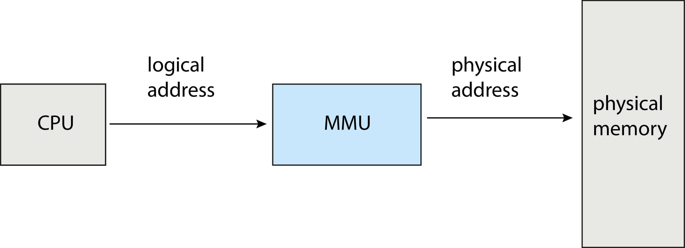
Memory-Management Unit (MMU)
Hardware device that at run time maps virtual to physical address

Slide 30
Memory-Management Unit (Cont.)
Consider simple scheme. which is a generalization of the base-register scheme.
The base register now called relocation register
The value in the relocation register is added to every address generated by a user process at the time it is sent to memory
The user program deals with logical addresses; it never sees the real physical addresses
Execution-time binding occurs when reference is made to location in memory
Logical address bound to physical addresses

Slide 31


Slide 32
Contiguous Allocation
Contiguous memory allocation means that each process is allocated a single continuous block of memory in the main memory (RAM).
In other words, all the bytes or words assigned to a process are stored next to each other in memory — no gaps.
Main memory is divided into two parts:
Operating System (OS) — usually in lower memory.
User processes — loaded into the remaining part.
When a process is loaded, it is given one contiguous block large enough to hold:
Its code,
Data, and
Stack.
Contiguous memory allocation is a memory allocation technique.
It allows to store the process only in a contiguous fashion.
Thus, entire process has to be stored as a single entity at one place inside the memory.

Slide 33
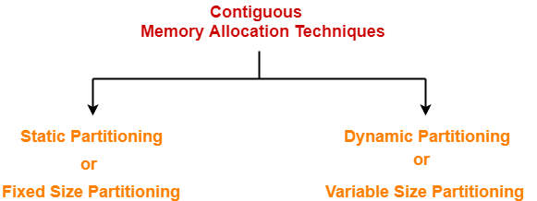

Slide 34
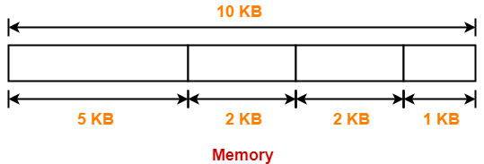
Static Partitioning
Static Partitioning-
Static partitioning is a fixed size partitioning scheme.
In this technique, main memory is pre-divided into fixed size partitions.
The size of each partition is fixed and can not be changed.
Each partition is allowed to store only one process.
These partitions are allocated to the processes as they arrive.
The partition allocated to the arrived process depends on the algorithm followed.

Slide 35
Static Partitioning
Popular algorithms used for allocating the partitions to the arriving processes are
First Fit Algorithm –
This algorithm starts scanning the partitions serially from the starting.
When an empty partition that is big enough to store the process is found, it is allocated to the process.
Obviously, the partition size has to be greater than or at least equal to the process size.
Best Fit Algorithm –
This algorithm first scans all the empty partitions.
It then allocates the smallest size partition to the process.
Worst Fit Algorithm –
This algorithm first scans all the empty partitions.
It then allocates the largest size partition to the process.

Slide 36
Static Partitioning
For static partitioning,
Best Fit Algorithm works best.
This is because space left after the allocation inside the partition is of very small size.
Thus, internal fragmentation is least.
Worst Fit Algorithm works worst.
This is because space left after the allocation inside the partition is of very large size.
Thus, internal fragmentation is maximum.

Slide 37
Dynamic Partitioning
Dynamic partitioning is a variable size partitioning scheme.
It performs the allocation dynamically.
When a process arrives, a partition of size equal to the size of process is created.
Then, that partition is allocated to the process.
The processes arrive and leave the main memory.
As a result, free memory areas(holes) of different size are created in the main memory.
These holes are allocated to the processes that arrive in future.
Partition allocation algorithms are used to decide which hole should be allocated to the arrived process.

Slide 38
Fragmentation
External Fragmentation – total memory space exists to satisfy a request, but it is not contiguous
Internal Fragmentation – allocated memory may be slightly larger than requested memory; this size difference is memory internal to a partition, but not being used

Slide 39
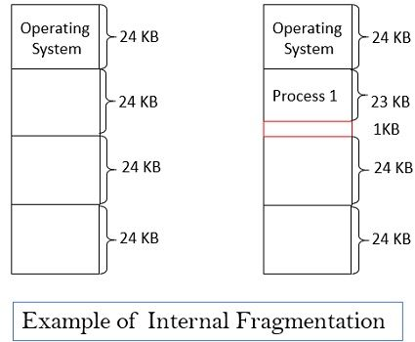

Slide 40
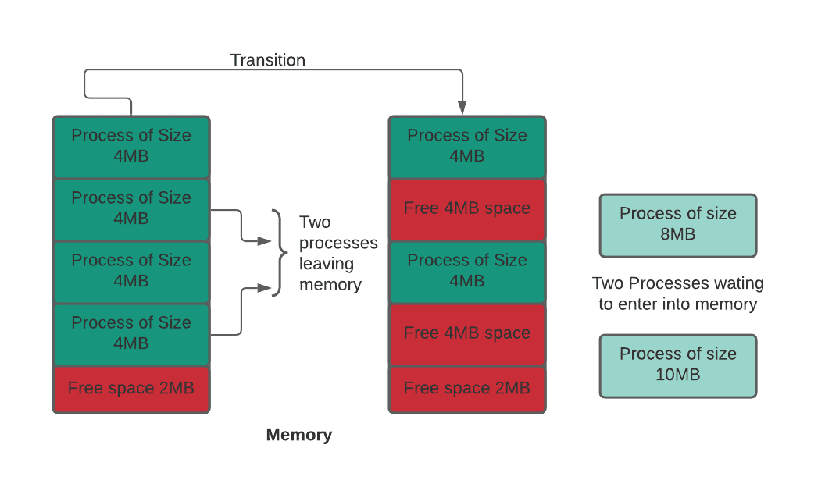
Example of External Fragmentation

Slide 41
Compaction
Compaction is a technique to collect all the free memory present in the form of fragments into one large chunk of free memory, which can be used to run other processes
It does that by moving all the processes towards one end of the memory and all the available free space towards the other end of the memory so that it becomes contiguous
It is not always easy to do compaction. Compaction can be done only when the relocation is dynamic and done at execution time.

Slide 42
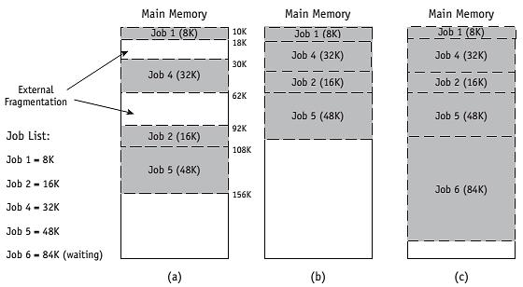
Compaction

Slide 43
Non-Contiguous Memory Allocation
Non-Contiguous Memory Allocation-
Non-contiguous memory allocation is a memory allocation technique.
It allows to store parts of a single process in a non-contiguous fashion.
Thus, different parts of the same process can be stored at different places in the main memory.
Techniques-
There are two popular techniques used for non-contiguous memory allocation-
Paging
Segmentation

Slide 44
Paging
Paging
Paging is a fixed size partitioning scheme.
In paging, secondary memory and main memory are divided into equal fixed size partitions.
The partitions of logical address space are called as pages.
The partitions of main memory are called as frames.
One page of the process must be saved in one of the given memory frames. These pages can be stored in various memory locations.
Process pages are usually only brought into the main memory when they are needed; else, they are stored in the secondary storage.

Slide 45
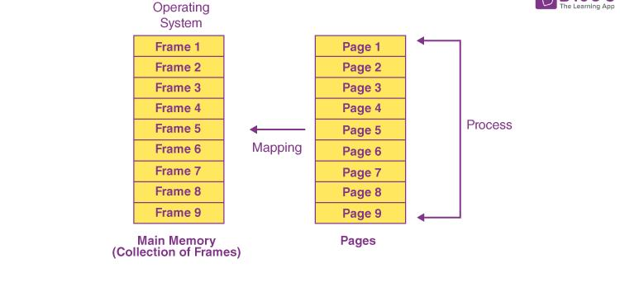
Paging

Slide 46
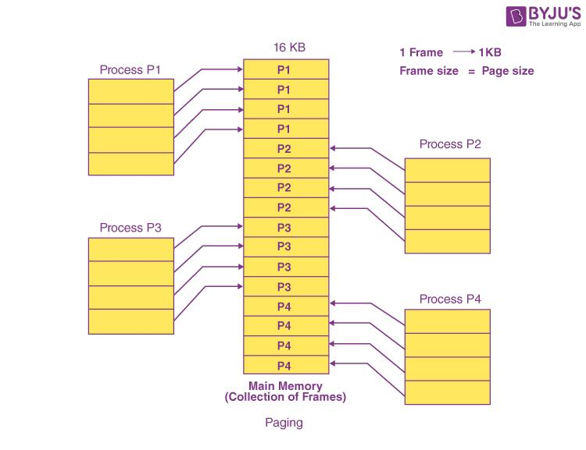
Paging
Assuming that the main memory is 16 KB and the frame size is 1 KB, the main memory will be partitioned into a collection of 16 1 KB frames. P1, P2, P3, and P4 are the four processes in the system, each of which is 4 KB in size. Each process is separated into 1 KB pages, allowing one page to be saved in a single frame.

Slide 47
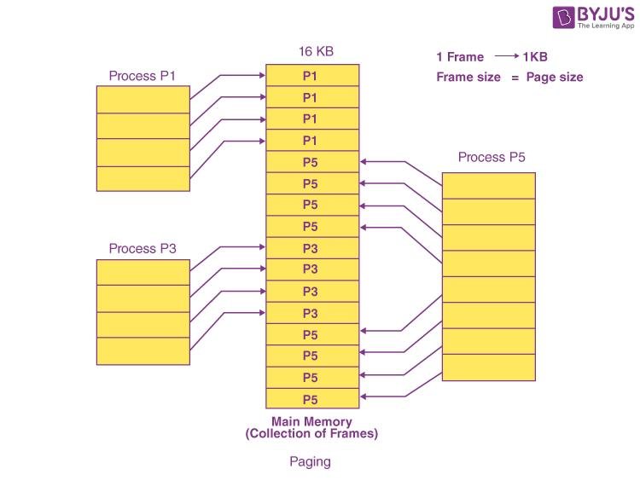
Paging
Suppose p2, p4 terminates and p5 from ready queue loaded into main memory

Slide 48
Address scheme mechanism
Address generated by CPU is divided into:
Page number (p) – (eg: page 2) used as an index into a page table which contains base address of each page in physical memory or it specifies the specific page of the process from which CPU wants to read the data.
Page offset (d) – (eg: 10th instruction) combined with base address to define the physical memory address that is sent to the memory unit or specifies the specific word on the page that CPU wants to read.
For the page number generated by the CPU,
Page Table(page no, frame no) provides the corresponding frame number (base address of the frame) where that page is stored in the main memory.
The frame number combined with the page offset forms the required physical address.
Frame number specifies the specific frame where the required page is stored.
Page Offset specifies the specific word that has to be read from that page.

Slide 49
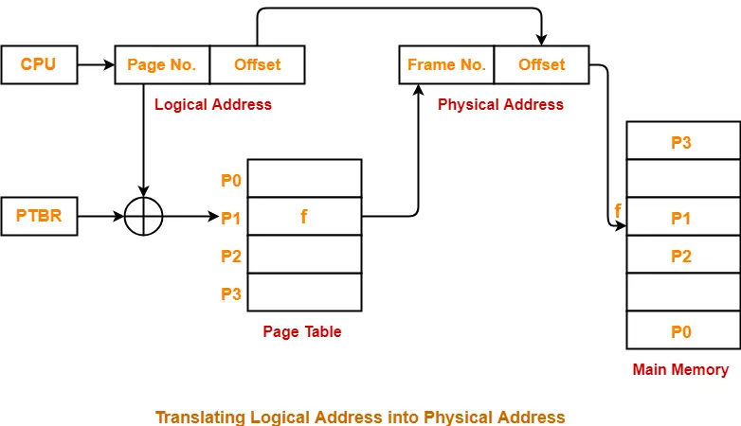

Slide 50
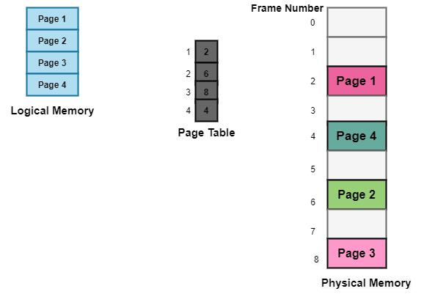
Page table
Data structure that is used by the operating system of a computer in order to store the mapping between physical and logical addresses is commonly known as Page Table.
Logical address that is generated by the CPU is translated into the physical address with the help of the page table.
Page table mainly provides the corresponding frame number (base address of the frame) where that page is stored in the main memory

Slide 51

Paging Hardware

Slide 52

Paging Model of Logical and Physical Memory

Slide 53

Paging Example
Logical address: Using a page size of 4 bytes and a physical memory of 32 bytes (8 pages)
Process(P) address space with 4 pages (P0,P1,P2,P3)
Physical address = (frame no x page size) + displacement/offset
Logical address 3 (page 0, offset 3)

Slide 54
Paging Example
Logical address 0 is page 0, offset 0. Indexing into the page table, we
find that page 0 is in frame 5. Thus, logical address 0 maps to physical address 20 (= (5 x 4) + 0).
Logical address 3 (page 0, offset 3) maps to physical address 23 (= (5 x 4) + 3).
Logical address 4 is page 1, offset 0; according to the page table, page 1 is mapped to frame 6. Thus, logical address 4 maps to physical address 24 (= (6 x 4) + 0).

Slide 55
Paging -- Calculating internal fragmentation
Page size = 2,048 bytes
Process size = 72,766 bytes
35 pages + 1,086 bytes
Internal fragmentation of 2,048 - 1,086 = 962 bytes
Worst case fragmentation = 1 frame – 1 byte
On average fragmentation = 1 / 2 frame size
But each page table entry takes memory to track
Page sizes growing over time

Slide 56

Free Frames
Before allocation
After allocation

Slide 57
Implementation of Page Table
Page table is kept in main memory
Page-table base register (PTBR) points to the page table
Page-table length register (PTLR) indicates size of the page table
In this scheme every data/instruction access requires two memory accesses
One for the page table and one for the data / instruction
The two-memory access problem can be solved by the use of a special fast-lookup hardware cache called translation look-aside buffers (TLBs) (also called associative memory).

Slide 58
Translation Look-Aside Buffer (TLB)
TLB is the cache for page table entries.
It reduces address translation time.
A TLB miss triggers a page table lookup, which is slower.
The TLB is associative, high-speed memory. Each entry in the TLB consists of two parts: a key (or tag) and a value.
When the associative memory is presented with an item, it is compared with all keys simultaneously.
If the item is found, the corresponding value field is returned. The search is fast; the hardware, however, is expensive. Typically, the number of entries in a TLB is small, often numbering between 64 and 1,024.
TLBs typically small (64 to 1,024 entries)
On a TLB miss, value is loaded into the TLB for faster access next time

Slide 59

Paging Hardware With TLB

Slide 60
Memory Protection
Memory protection implemented by associating protection bit with each frame to indicate if read-only or read-write access is allowed
Can also add more bits to indicate page execute-only, and so on
Valid-invalid bit attached to each entry in the page table:
“valid” indicates that the associated page is in the process’ logical address space, and is thus a legal page
“invalid” indicates that the page is not in the process’ logical address space
Any violations result in a trap to the kernel

Slide 61

Valid (v) or Invalid (i) Bit In A Page Table

Slide 62
Shared Pages
Shared code
One copy of read-only (reentrant) code shared among processes (i.e., text editors, compilers, window systems)
Similar to multiple threads sharing the same process space
Also useful for interprocess communication if sharing of read-write pages is allowed
Private code and data
Each process keeps a separate copy of the code and data
The pages for the private code and data can appear anywhere in the logical address space

Slide 63

Shared Pages Example

Slide 64
End of Chapter 9

